Slide 1
machine learning model deployment using IBM cloud watson studio.

Slide 2
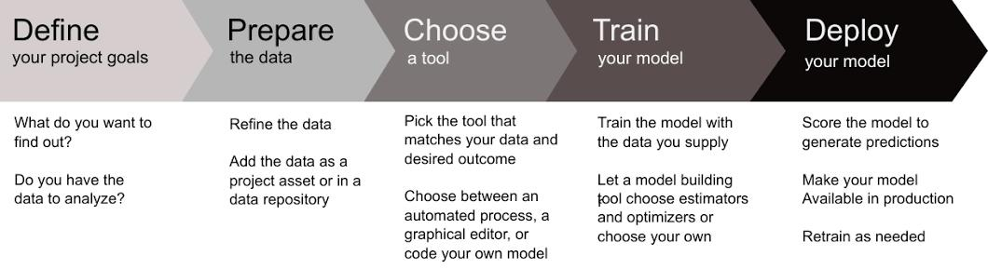
Abstract of the project:-
IBM Watson Studio provides tools for data scientists, application developers and subject matter experts to collaboratively and easily work with data to build and train models at scale. It gives you the flexibility to build models where your data resides and deploy anywhere in a hybrid environment so you can operationalize data science faster.

Slide 3
Proposed system:-
Create a project in IBM Watson Studio Dashboard and assign a Cloud object Storage service to manage datasets.
Cloud Object Storage is a storage service in IBM Cloud. We use this service to manage our datasets for training the ML Model and store required files.
Add a jupyter notebook instance in your project to Develop and Deploy Machine Learning Model.
Import WatsonMachineLearningAPIClient library. Watson studio uses Watson Machine Learning service credentials to access WML service, so paste the credentials.

Slide 4
Software /hardware used:-
Watson Studio provides the environment and tools for you to collaborately work on data to solve your business problems. You can choose the tools you need to analyze and visualize data, to cleanse and shape data, to ingest streaming data, or to create and train machine learning models.
IBM Watson® Studio empowers data scientists, developers and analysts to build, run and manage AI models, and optimize decisions anywhere on IBM Cloud Pak® for Data. Unite teams, automate AI lifecycles and speed time to value on an open multicloud architecture.

Slide 5
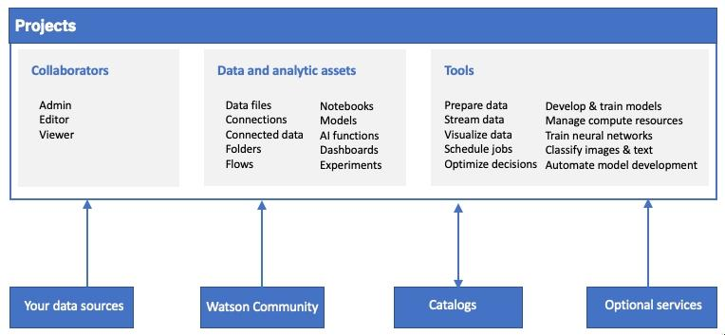
Existing system:-
IBM Cloud watson studio.
Jupyter notebook
IBM Cloud.
WML API Client

Slide 6
Thank you...

